Slide 1
Research at Yale
Peiqin Gu, 7/12/2012

Slide 2
Related Projects
Text Mining on Web Data (Feb-March)
Pubmed TCM-related literatures
GWAS-based pathway analysis (April-now)
Statistics & database computation
Semantic-assisted Protein Association Analysis (April-now)
Protein motion ontology & rule-based automatic classification
Linked Data hub for web data integrating and sharing
All the projects started from nothing, and almost all by myself, yet I worked with domain experts.

Slide 3
1. Text Mining on Web Data
Background
Though Traditional Chinese Medicine has been studied a lot, it is not as open as western medicine, in terms of decentralized research groups, non-standardized data sources, and various medical applications.
Methods
Fetch TCM related articles from Pubmed: public APIs for Pubmed
Semi-supervised named entity recognition
Part-of-speech tagging
Rule-based named entity recognition
Statistic-based entity recognition
Results
The key words appeared together with some terms frequently, e.g. herb, medicine, etc.
A list of identified data sources.

Slide 4
Challenges & Solutions
Aim: identify possible TCM data sources, such as databases, ontology, etc.
Challenges
Phrase chunking can not distinguish data source terms from other noun phrases, e.g. organization, protein names, diseases, etc. which become the noisy data in mining process.
The text mining results are not very convincing due to the lack of a comprehensive corpora.
Without enough domain knowledge, it is hard to evaluate the results of text mining.
Solutions
Apply rule-based recognition methods upon pos tagging data
Allow human experts supervision

Slide 5
2. SNP-based pathway analysis for GWAS data
Data: Unpublished SNP data from several cohorts, e.g. tar.gz
Tar.gz: dosage, fam, map (3 kinds of files, 22 chromosomes)
Methods
Data merging: merge the data from different cohorts into a big matrix.
Genotype reconstruction: convert p-value data to genotype information, based on the threshold of 0.9.
Plink data clean: clean the problematic genes and individuals
PCA regression: implemented by Clarence
Pathway merging: merge pathways based on several principles using RDF graph
Results
Statistical p-value based pathways
Semantic integrated pathway merging
A list of biologically meaningful pathways

Slide 6
Initial data
1252807 (rows) * 34979 (columns)
200GB
Chr 1
…
bel
snp data
SNP id | Minor allele | Major allele | Individual 1 (FID, IID) | Individual 2 (FID, IID) | …
rs00001 | A | T | 0.8023 0.1434 | 0.2387 0.4781 | …
rs00002 | C | G | 0.3767 0.6231 | 0.0389 0.9624 | …
…
Chr 22
germ
snp data
merge
…
nidk
snp data
Pathway | Gene sets
p1 | g1, g2, …
… | …
Genotype reconstruction
Pathway analysis
Gene | P-value
gene1 | 0.065
gene2 | 0.323
… | …
Data clean
SNP id | Minor allele | Major allele | Individual 1 (FID, IID) | Individual 2 (FID, IID) | …
Rs00001 | A | T | A A | 0 0 | …
rs00002 | C | G | 0 0 | C G | …
…
PCA regression
Imputed data
26439 genes

Slide 7
Challenges & Solutions
The first complete workflow to deal with such large-scale gene data.
Input: Beagle data
Analysis tool: Plink tool
Work flow: Java framework
Introduce semantic technologies into pathway merging
Platform: Oracle 11g2
Capabilities: RDF/OWL storage, sparql-embedded query
Cases: graph pattern based pathway merging

Slide 8
class
Pathway Ontology
Pathway
p1
p2
g5
p1
type
p2
g4
g1
g2
g3
class
relates_to
Gene
g1
relates_to
Merging patterns:
High ratio of overlapping genes: >=90%, e.g. the ratio between p1 and p2 is 1/3 = 33%.
Subset inclusion between gene sets
Identical pathway names
Equivalent pathway names
Multi-pathway merging
type
g2
g3
g4
g5

Slide 9
The advantages of using semantic Oracle
The intermediate result of gene-based pathway analysis is large yet in simple structure, which requires scalable computation power, e.g. Oracle database.
The relationship between pathway and gene is explicit and directional, but one to multiple. So the whole data set can be viewed as a huge graph, for which semantic technologies in Oracle 11g can support knowledge-aware query.
Instead of multiple joins, semantic Oracle provides users with a solution of graph pattern based query, e.g.
SELECT p1, p2, count(gene)
FROM TABLE (sem_match ('(?p1 promo:relates_to ?gene)
(?p2 promo:relates_to ?gene)',
sem_models('pathway'),
null,
null,
null));

Slide 10
3. Semantic-assisted Protein Association Analysis
Background
MolMovDB (Molecular Movements Database) presents manually curated descriptions of conformational changes in hundreds of distinct proteins. It is arranged around a multi-level classification scheme and includes motions of loops, domains, and subunits. Semantic technologies serve as a web-based support for knowledge integration, knowledge discovery on a broader scale.
Steps
Ontology modeling: present a well-defined OWL ontology for protein motions, also web-accessible.
Inference-based classification: users can customize the rules for the ontology, in order to enable automatic classification.
Linked data integration: we store the data in a linked data server, so that advanced query upon multiple data sources can be issued.
Results
The first ontology built for protein motions
A innovative application to integrate protein information through an ontological hub.

Slide 11
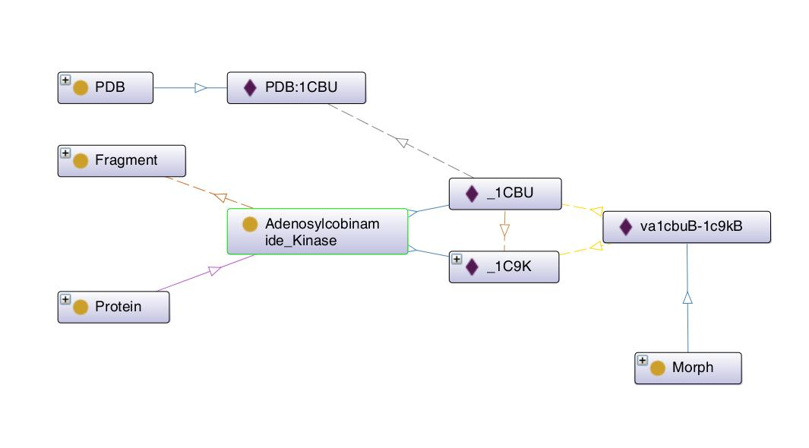
Adenosylcobinamide Kinase: specific protein, as a class
Protein: a concept, as a superclass
_1CBU: one conformation of Adenosylcobinamide_Kinase, as an individual of Adenosylcobinamide_Kinase
_1C9K: one conformation of Adenosylcobinamide_Kinase, as an individual of Adenosylcobinamide_Kinase
va1cubuB-1c9kB: a specific morph id, as an individual
Morph: a concept, as a superclass
PDB: a protein data bank
PDB:1CBU: pdb id
Rules: classify the proteins to defined scheme based on properties
[rule1: (?a rdfs:subClassOf promo:Protein), (?a rdfs:subClassOf ?b), (?b owl:allValuesFrom promo:Fragment), (?x rdf:type ?a), (?y rdf:type ?a), (?x promo:shear ?y) -> (?a rdfs:subClassOf promo:F-S-2)]

Slide 12


Meta-information, background information
Editor tool
RDF Graph
Inference function
URI
Information providers
Linked Data
Meta-information, background information
Query interface
RDF Graph
URI
Information providers
Signature, authority information
Information consumers
Mapping tool
RDF triples
Relational databases

